Slide 1
Electrical Circuits
EEE-281 Lecture Notes
Dr. Özçel Cangül
Lecture Notes by: Dr. Ali Muhtaroğlu
Fall 2023
METU Northern Cyprus Campus
References:
Electric Circuits 10th Ed. by Nilsson & Riedel
Electrical Circuit Analysis 3rd Ed. by Johnson, Johnson, Hilburn, and Scott
Engineering Circuit Analysis 7th Ed. by Hayt, Kemmerly, and Durbin
Fundamentals of Electric Circuits 3rd Ed. by Alexander, and Sadiku

Slide 2
Operational Amplifiers
Week 10
Reading: Nilsson & Riedel Chapter 5
Ali Muhtaroğlu

Slide 3

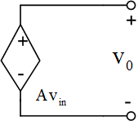
Operational Amplifiers
Operational Amplifier (Op-Amp) is an electronic device that under proper circumstances behaves like a voltage-controlled voltage source (VCVS) with very high gain.
Symbol:
+ : Non-inverting Input
- : Inverting Input
+/– Vcc power supply often not shown
Op-Amp Ideal Voltage Amplifier Model
Open Loop Gain :

Slide 4
Operational Amplifiers
Operational Amplifier (Op-Amp) is an electronic device that under proper circumstances behaves like a voltage-controlled voltage source (VCVS) with very high gain.
Actual characteristic:
Positive saturation
Linear (VCVS) region
Negative saturation

Slide 5
Operational Amplifiers
Operational Amplifier (Op-Amp) is an electronic device that under proper circumstances behaves like a voltage-controlled voltage source (VCVS) with very high gain.
Ideal Op-Amp Approximations :
                1.No current ever flows into either input terminal :
Op-Amp Ideal Voltage Amplifier Model
Open Loop Gain :

Slide 6
Example 1
Determine voltages and . Use ideal op-amp model. A=100000.

Slide 7
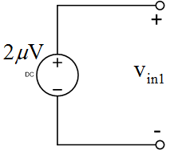
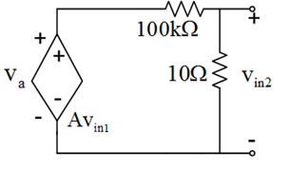
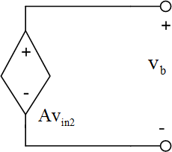
Example 1
Determine voltages and . Use ideal op-amp model. A=100000.
Ideal Model :

Slide 8
Negative Feedback
Op-Amp gain (A) varies due to many factors:
• Manufacturing process variations
• Temperature variations
• Voltage fluctuations due to activity/noise
• Material aging
Negative feedback topology helps compensate for most of these variations and increases the overall accuracy of the output by making the circuit more immune to such variations.

Slide 9
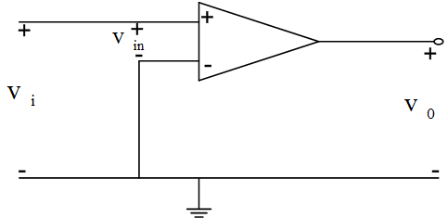
Negative Feedback
A simple Op-Amp circuit without negative feedback:
A simple Op-Amp circuit with negative feedback:
but
For +/- 5% variation in A:
The effective error in A’ is reduced from 5% to +/-0.0005% !
It is important to realize there is an increased cost associated with this benefit: With negative feedback, the effective gain (A’) reduces in magnitude, which means other components (e.g.resistors) will need to be added to boost up gain.
Assume +/- 5% variation in opamp gain A.
If , then
where : : circuit gain including variations

Slide 10
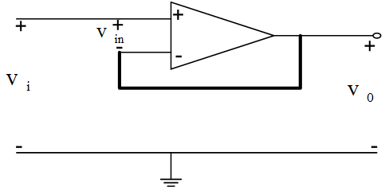
Negative Feedback
A simple Op-Amp circuit without negative feedback:
A simple Op-Amp circuit with negative feedback:
Assume +/- 5% variation in opamp gain A.
If , then
where : : circuit gain including variations

Slide 11
Negative Feedback
A simple Op-Amp circuit without negative feedback:
A simple Op-Amp circuit with negative feedback:
but
For +/- 5% variation in A:
The effective error in A’ is reduced from 5% to +/-0.0005% !
It is important to realize there is an increased cost associated with this benefit: With negative feedback, the effective gain (A’) reduces in magnitude, which means other components (e.g. resistors) will need to be added to boost up circuit gain.
Assume +/- 5% variation in opamp gain A.
If , then
where : : circuit gain including variations

Slide 12
Negative Feedback
Back to Ideal Op-Amp Approximations:
A simple Op-Amp circuit with negative feedback:
but
For +/- 5% variation in A:
The effective error in A’ is reduced from 5% to +/-0.0005% !
It is important to realize there is an increased cost associated with this benefit: With negative feedback, the effective gain (A’) reduces in magnitude, which means other components (e.g. resistors) will need to be added to boost up circuit gain.
1. No current ever flows into either input terminal (for any ideal op-amp)
2. There is no voltage difference between the two input terminals:
(for any ideal op-amp in negative feedback topology, and operating in linear region.)

Slide 13
Example 2
Find v in the below circuit (assume Ideal Op-Amp model):

Slide 14
Example 2
Find v in the below circuit (assume Ideal Op-Amp model):
Voltage division:
(remember due to the 1st ideal op-amp rule)
Using the 2nd ideal op-amp rule:
Voltage division:
Next, will look at some well-known Op-Amp building block circuits
with negative feedback…

Slide 15
Inverting Amplifier
Nodal analysis method is typically appropriate for amplifier circuits

Slide 16
Inverting Amplifier
Nodal analysis method is typically appropriate for amplifier circuits:
Rule 1: No current flows into the inputs of the Op-amp.
Therefore writing KCL equations at node :
Rule 2: The input volages are ~the same for the op-amp, since negative feedback exists
So;
Therefore, the equation (1) becomes: : Inverting Amplifier Gain

Slide 17
Inverting Amplifier (example)
Using values:

Slide 18
Inverting Amplifier (example)
Using values:
Inverting amplifier

Slide 19
Inverting Amplifier (example)
Using values:
Note:
If , then get negative amplification of the input voltage
If , then get attenuation of the input voltage
Inverting amplifier

Slide 20
Noninverting Amplifier

Slide 21
Noninverting Amplifier
Using nodal analysis again:
Rule 1: No current flows into the inputs of the
Op-amp.
Therefore writing KCL equations at node :
Rule 2: The input volages are ~the same for the Op-amp
So;
Therefore, the equation (1) becomes:
: Noninverting Amplifier Gain

Slide 22
Noninverting Amplifier(Example)
Noninverting amplifier

Slide 23
Difference Amplifier

Slide 24
Difference Amplifier
Using nodal analysis
Writing KCL equations at node :
Writing KCL equations at node :
By ideal Op-amp rules:
Subst. into (1):
i.e. this amplifier computes the
difference between the two voltages

Slide 25
Example 3 (Johnson & Johnson P:99)
Find the voltage transfer equation for the below circuit. Use the
ideal voltage amplifier model for the op amps.

Slide 26
Example 3 (Johnson & Johnson P:99)
Find the voltage transfer equation for the below circuit. Use the
ideal voltage amplifier model for the op amps.
KCL at input of the left hand
amplifier :
But by 2nd ideal op-amp rule.
Thus,
(1) becomes:

Slide 27
Example 3 (Johnson & Johnson P:99)
Find the voltage transfer equation for the below circuit. Use the
ideal voltage amplifier model for the op amps.
KCL at input of the left hand
amplifier :
But by 2nd ideal op-amp rule.
Thus,
(1) becomes:
KCL at input of the right hand amplifier & substituting for from (1):

Slide 28
Example 3 (Johnson & Johnson P:99)
Find the voltage transfer equation for the below circuit. Use the
ideal voltage amplifier model for the op amps.
KCL at input of the left hand
amplifier :
But by 2nd ideal op-amp rule.
Thus,
(1) becomes:
KCL at input of the right hand amplifier & substituting for from (1):
Voltage division for the input of the right hand amplifier :

Slide 29
Example 3 (Johnson & Johnson P:99)
Find the voltage transfer equation for the below circuit. Use the
ideal voltage amplifier model for the op amps.
KCL at input of the left hand
amplifier :
But by 2nd ideal op-amp rule.
Thus,
(1) becomes:
KCL at input of the right hand amplifier & substituting for from (1):
Voltage division for the input of the right hand amplifier :
But so, set (2) = (3) :

Slide 30
Improved Op-Amp Model
• The ideal model projects no current draw from the input source, and the power delivered to the load at the output may be infinitely large if load resistance is small (v²/R).
• In reality there is always some current draw at the inputs, however small, and there is a finite output resistance, as shown in the below improved model.
Typical values for common op-amps are:

Slide 31
Example 1 repeated w/ improved model
Determine voltages and . Use improved op-amp model.

Slide 32
Example 1 repeated w/ improved model
Determine voltages and . Use improved op-amp model.
Improved Model:

Slide 33
Example 1 repeated w/ improved model
Determine voltages and . Use improved op-amp model.
Improved Model:
By KVL :

Slide 34
Example 1 repeated w/ improved model
Determine voltages and . Use improved op-amp model.
Improved Model:
By KVL :
By voltage division:

Slide 35
Example 1 repeated w/ improved model
Determine voltages and . Use improved op-amp model.
Improved Model:
By KVL :
By voltage division:
Comparing w/ ideal model solution(Page 6), the difference is small. This is due to the design of the circuit and the value of the resistors chosen.

Slide 36
Example 4
Assume for the Op-Amp: , , . Determine .

Slide 37
Example 4
Assume for the Op-Amp: , , . Determine .
Replace Op-Amp by the Improved Model:

Slide 38
Example 4
Assume for the Op-Amp: , , . Determine .
Replace Op-Amp by the Improved Model:
Thevenin to the left of a-b:

Slide 39
Example 4
Assume for the Op-Amp: , , . Determine .
Replace Op-Amp by the Improved Model:
Thevenin to the left of a-b:
The circuit becomes :

